Slide 1
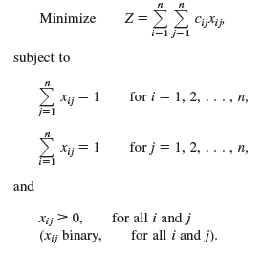
The Assignment Problem (1/3)
x_{ij} can have only values zero or one
One if assignee i performs task j
Zero if not

Slide 2
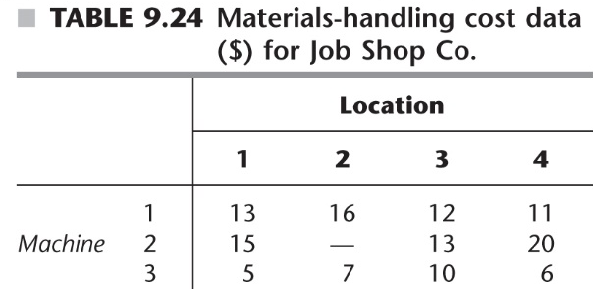
The Assignment Problem (2/3)
The Job Shop problem (P348-349)
Assign new machines to locations to minimize total cost of materials handling

Slide 3
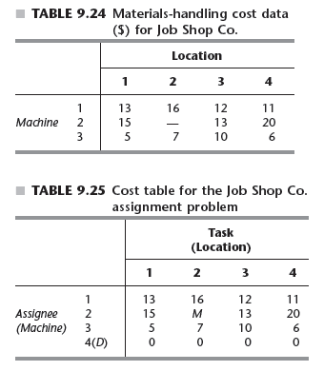
The Assignment Problem (3/3)
The Job Shop problem (P348-349)
Assign new machines to locations to minimize total cost of materials handling

